Slide 1
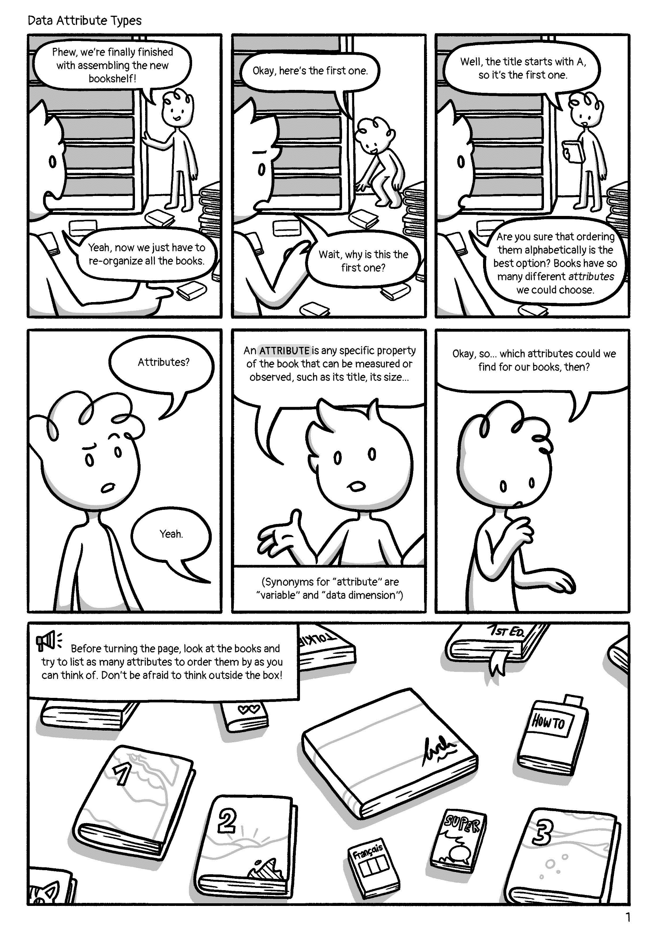
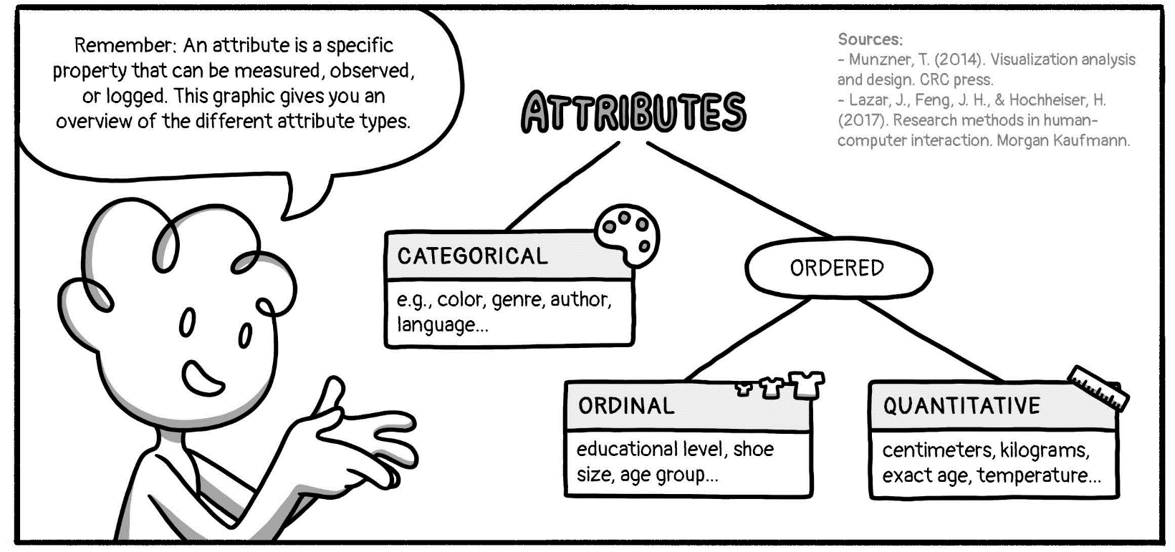

In general:
Attribute Types © 2022 by Comixplain
https://www.comixplain.cc
e.g., color, genre, author, language…
educational level, t-shirt size, age group…
centimeters, kilograms, exact age, temperature...

